Slide 1
Namma Yatri
Management strategy
Presentation by Ambar Chaudhari

Slide 2
Objective
Create a management guide for
Boosting conversion rate,
Adding more trips
Adding distance for ride
of Namma Yatri Cab
services

Slide 3
Market Overview
Indian cab market has size of USD 23.98B for year 2026
Which is projected to grow at rate of 7.78% till 2031.
The estimated size of Indian cab market will be 34.87B by 2031
So, it is fast-growing market we must focus on increasing our revenue by more than 15%
Our biggest competitor are Ola and Uber
They work on commission model we are revolutionizing it changing it to subscription model
Source – Mordor Intelligence

Slide 4
Key analysis on Namma Yatri dataset
Conversation rate is key factor in number of successful rides
Distance driven, successful rides and Revenue generated are positively co-related.
Charing more per Km does not significantly increases the revenue as customers cancel the rides.
The number of successful rides are dropping in peak hours(morning (8 AM – 10 AM) and evening (6 PM – 9 PM)).
Customer tends use credit card and debit cards when they use our service regularly.

Slide 5
Conversation Rate
Improving conversation rate can significantly boost our revenue.
Average conversation rate of Namma Yatri is 45.49%.
For some location quite its low.
We should improve it by sending targeted ads, installing billboards, send proper estimation and avoiding driver and customer cancelation.
To avoid driver cancelation incentives, them with more commission or vouchers.
The customer satisfaction must improve so there are less cancelation from there sides.

Slide 6
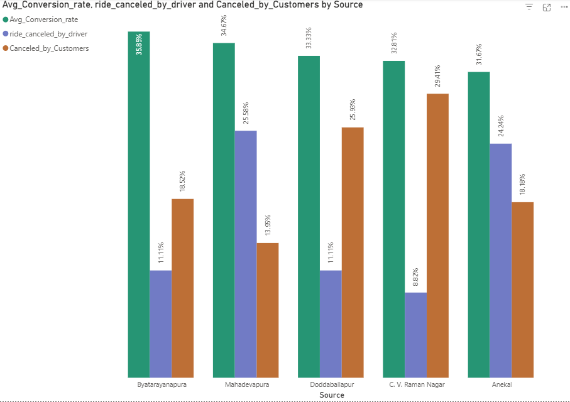
Low conversion rate zones
Theses pick up zones has low conversion rate and high cancelation rate
Anekal
Byatarayanapura
C. V. Raman Nagar
Doddaballapur
Mahadevapura.
Suggestions
These locations has revenue of INR 82K.
Improving conversion and cancelation rate is needed in these locations.
Considering 20% growth in successful rides the revenue will jump to INR 104K in these location

Slide 7
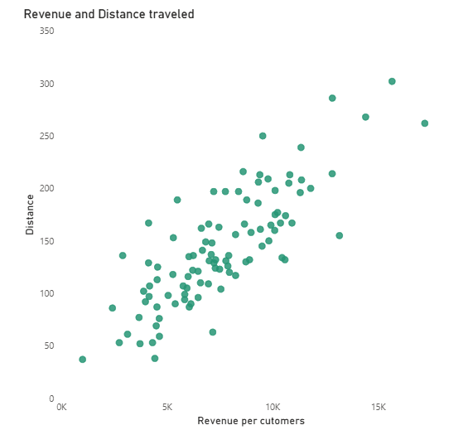
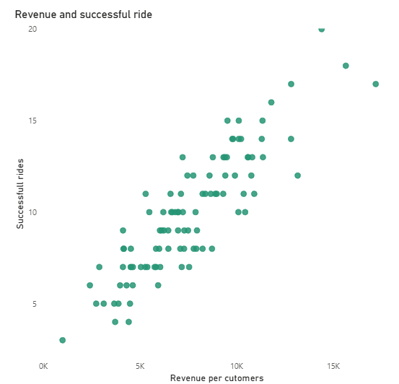
Co-relation with revenue
Revenue and distance co-relation = 0.81
Revenue and successful ride co-relation = 0.88
Looking at above visual we can clearly see co-relation between distance driven, successful rides and revenue generated. Adding a greater number of trips with more distance we can increase average revenue per user.

Slide 8
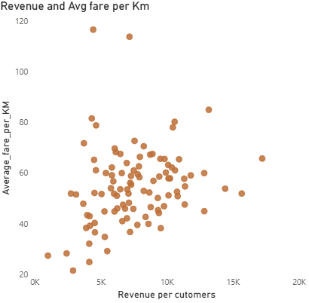
Co-relation Fare per Km and revenue
Co-relation for fare per Km and revenue = 0.24
There is low co-relation between fare per Km and revenue.
As customer tends to cancel because of soaring prices
High Prices per Km sometimes balances low demand makes less impact on revenue.

Slide 9
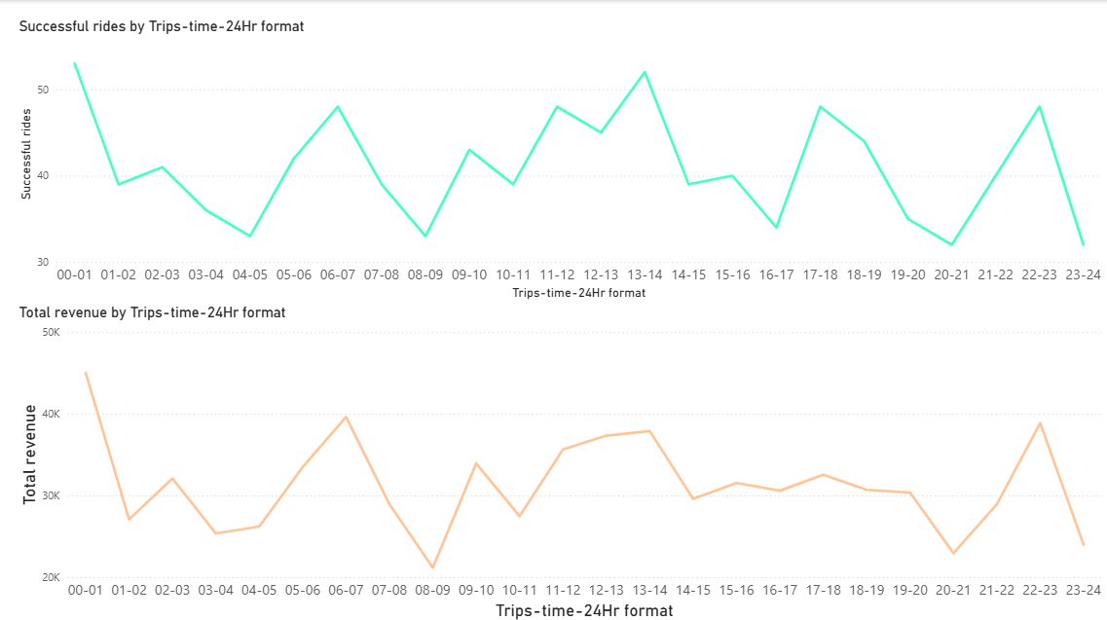
Drop off revenue in peak hours
Drop of rides in peak hours makes loss in revenue
The customer traveling in peak hours are traveling to office, collage students, etc
These customer want cab service that is reliable, punctual and affordable.
To get this customer we must make advertisements that highlight our service as reliable,punctual and affordable

Slide 10
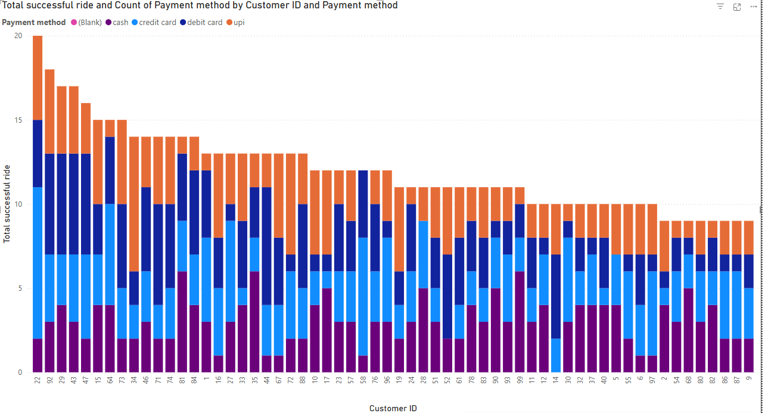
Payment Method
As customer starts using our service . His payment method shift from upi and cash to debit and credit cards.
This is because customer might trust us with cards and it will be easier to pay with card .
We can use this as an indicator to know that customer will be using service for long time.
To promote card use we can tie up with bank and give special offer to customer that uses card. This might reduce our churn rate.

